Slide 1
Exam 1: Study Guide
Exam 1 will cover lectures 1 and 2 a and b, or HW 1.
The exam is in-class on the date indicated on the Master Schedule.
You will have 45 minutes to complete it. Small calculators are allowed, but I don't think you will need one.
Closed book, closed notes. Cheating is an automatic 0 and will likely land you at the Dean's office.
Study the lecture power points (at this stage, not from the book), review the solutions to HW 1 and the sample exam posted here.
Usually they say "Good Luck", but doing good on a test is not really a matter of luck, so Good Work!
Willie

Slide 2
Review solutions to HW 1 A and B. Questions on the exam are likely to come from the pool of questions on these HWs.
High points:
1) Visible lines are solid and thicker than hidden lines. Hidden lines are dashed and thinner that visible lines. Other lines are described in the lectures. Review them all.
2) Visible lines take precedence over hidden lines. Hidden lines take precedence over symmetry/center lines.
5) Practice your miter lines to build side views (either left or right) from front and top views. I may ask you to use the miter line to locate a feature on a side view from other given views.
6) There are 6 primary views, but you should sketch only the ones needed to show all profiles visible on at least one view, and all features visible on at least one view.
7) Recall that there are two systems used for projecting multiviews: third and first angle systems. The standard (imperial or "inch") system uses the third angle, while the metric system uses the first angle. Study the differences between these two systems from the lectures. I may ask you questions about them. If not stated otherwise, the exam will follow the third angle projection system.

Slide 3
First- and Third-Angle Projections
There are two main systems used for projecting and unfolding the views:
  Third-angle projection which is used in the United States, Canada, and some other countries
  First-angle projection which is primarily used in Europe and Asia
You should understand both methods.
Watch these animations:
  Third-Angle
  First-Angle

Slide 4
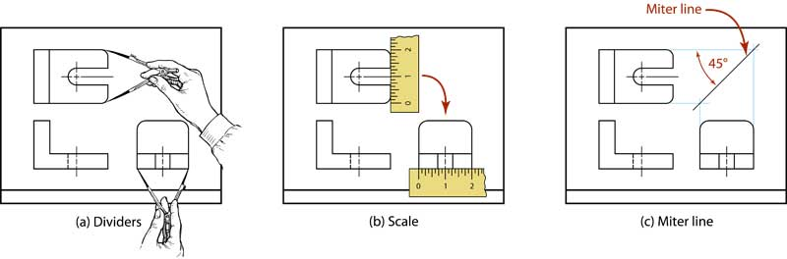
Principal Dimensions
The principal dimensions in the views must correspond
  You may find it convenient to use dividers, a scale, or a 45-degree miter line to project dimensions.
Watch the animation here.

Slide 5
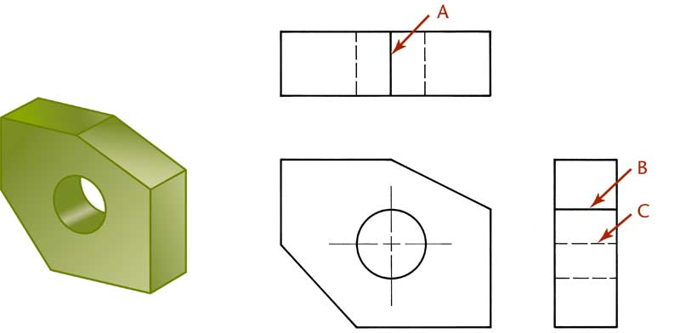
Precedence of Lines
When lines coincide on a drawing the rules of precedence are:
  Visible lines always take precedence over hidden or center lines.
  Hidden lines take precedence over center lines.
Watch the animation here.

Slide 6


Questions?

